Slide 1

Implementing housing affordability Post Pandemic

Slide 2

AGENDA
Introduction
Demographics and Statistics
Code Based Solution
Conclusion

Slide 3

Introduction - During the pandemic covid-19 pandemic, home prices surged, and supply plummeted to the point that now regular citizens cannot keep up. - 49% of Americans say affordable housing availability is a major problem in their community, up from 39% in early 2018 (Pew research center, Jan 2022). - the housing in the United States has increase by 10% since 2018 - this presentation will showcase the problem in housing and provide a solution for the current problem.

Slide 4

Who is mostly concerned and affected about affordable housing? - Studies show that Young American, Urban residents and lower-income individuals are mostly the ones concerned and affected by the status. - About 36%of U.S. adults say it’s a minor problem, while 14% say its not a problem (Pew Research center , Jan 2022)
AFFORABLE HOUSING VS. OTHER PROBLEMS
- Housing has become such a problem that 49% of adult think it’s a serious issue which makes it higher than Drug addiction which is at 35%, economic impacts of covid-19 (34%), Health impacts of covid-19(26%) and crime(22%) (PEW RESEARCH CENTER, Jan 2022)

Slide 5
Demographic Differences in concern
After the pandemic, the income rate for individuals was no longer keeping up with their leaving situations as now per average household gives up at least 32% of their income to rent or mortgages for housing. (Brookings, Oct 2019) The following information shows the demographics concerned based on income:
Income:
Lower-income households: 57%
Middle-income households: 47%
Upper-income households: 42%
America is heavily influenced by race and ethnicity, as much as it strives for equality sometimes its never the case as we find that as per one’s ethnicity and race, they are charged differently when it come to rent, and housing and they may receive different income due to their race and ethnicity.(Stewart, N, Aug 2022) The information below shows the demographic of race that worries more about their rent .
Race and Ethnicity:
Black: 57%
Hispanic & Asian: 55%
White: 44%

Slide 6

Influence of age and location
Covid-19 heavily influenced the prices and surged them based on the location in which you wanted to buy which has always been the case and what age you want to but a house at which was never the case in the late 90’s to early 2000’s. The following information below are the demographics in which the surge of rent and housing has influenced based on age and location:
Age:
18-29 and 30-49: 55%
50-64: 44%
65+: 39%
Location:
Urban: 63%
Suburban: 46%
Rural: 40%

Slide 7
Regional and partisan perspectives
AS WE ALL KNOW THAT THE PANDEMIC AFFECTED AREAS AND REGIONS DIFFERENTLY SOME HAD A BETTER EXPERIENCE THAN OTHER SAME GOES FOR RENT AND HOUSING CERTAIN REGIONS WERE AFFECTED MORE THAN OTHERS. The following below shows the areas that are deeply concerned as they have not seen a change in years. (Pew Research center, Jan 2022)
Regional:
West: 69%
Northeast: 49%
South: 44%
Midwest: 33%
PARTISAN:
Democrats and learners: 59%
Republicans and learners: 36%
Urban Democrats: 67%
Urban Republicans: 54%
Suburban and Rural Democrats: 56% and 54%
Suburban and rural Republicans: 35% and 31%

Slide 8
Solution to this Problem
Using the information collected the best solution is that companies should start making U.S citizens rent based on their , location, post-tax income and other demographic conditions rather than the fixed pay they create.
This would create a flow in which that people can pay.
This will reduce the housing market to a more realistic percentile as the current is very unreachable to many.
With this information I have also devise a code that would solve the problem.

Slide 9

Pseudocode
Define tax brackets and rates.
Define location-specific rent to income ratios.
Define housing policy limits.
Create a function to calculate taxes based on yearly income.
Create a Function to calculate eligible rent based on post tax income, location ,and housing policy.
Create the main function to interact with the user and display results.
Run the main Function.

Slide 10
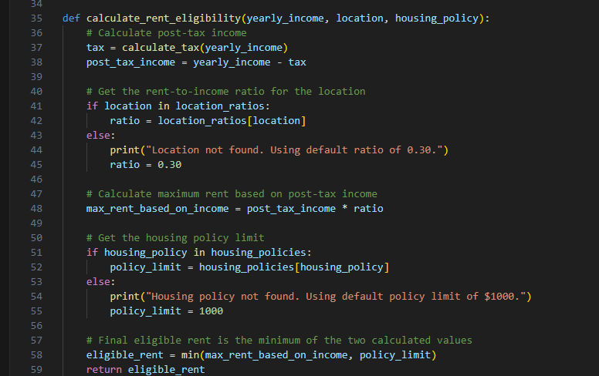
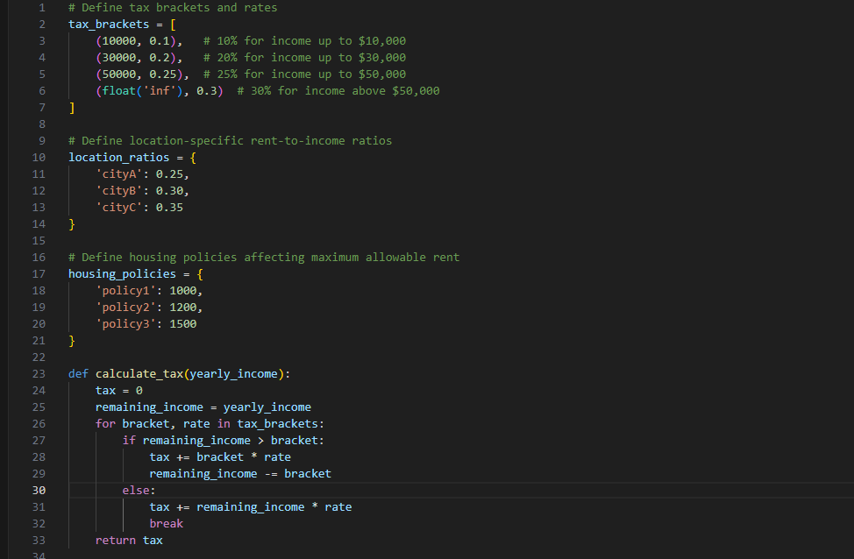
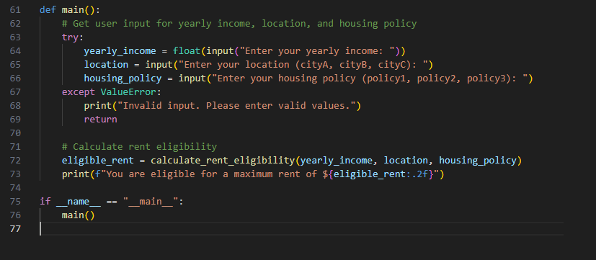
SOLUTION CODE

Slide 11
User interaction
Prompt for Yearly Income: The program will ask the user to input their yearly income.
Prompt for Location: The user will be asked to enter their location (city A, City B, or city C).
Prompt for Housing Policy: The user will be asked to specify the housing policy they are under (policy 1, policy 2, or policy 3).
Display Result: The program calculates and displays the maximum rent the user is eligible for based on their inputs.

Slide 12
Code Explanation
The code starts by defining tax brackets, location-specific rent-to-income ratios, and housing policy limits.
The ‘calculate_tax’ function computes the tax based on the user’s yearly income.
The ‘calculate_rent_eligibility’ function calculates the user’s eligible rent based on their post-tax income, location and housing policy
The ‘main’ function handles user inputs and outputs the eligible rent.
This script provides a clear and interactive way for users to determine their eligible rent based on the specified criterial, ensuring a user-friendly experience.

Slide 13
Conclusion
This presentation show cases the concerns on housing and rent since 2018 across all demographics, For which Young Adults(under 30): 55% which has increase from 39% in 2018. Adults above 30 -49: 55% which increased from 42% in 2018
This presentation also emphasizes on the growing importance of addressing affordable housing issues.
It also presented with a solution which could be implemented both in social abstract and systematic abstract as a python code detailing a way to in which this crisis can be solved.

Slide 14

Bibliography
1. Stewart, N. (2022, August 1). *Public Housing Is an American Essential. Biden’s Plan Could Finally Make it Better*. TIME. Retrieved from [https://time.com/6900050/public-housing-biden-plan-housing/](https://time.com/6900050/public-housing-biden-plan-housing/)
2. Diamond, R., McQuade, T., & Qian, F. (2019, October 18). *What does economic evidence tell us about the effects of rent control?* Brookings Institution. Retrieved from [https://www.brookings.edu/articles/what-does-economic-evidence-tell-us-about-the-effects-of-rent-control/](https://www.brookings.edu/articles/what-does-economic-evidence-tell-us-about-the-effects-of-rent-control/)
3. Parker, K., Horowitz, J. M., & Brown, A. (2022, January 18). *A growing share of Americans say affordable housing is a major problem where they live*. Pew Research Center. Retrieved from [https://www.pewresearch.org/short-reads/2022/01/18/a-growing-share-of-americans-say-affordable-housing-is-a-major-problem-where-they-live/](https://www.pewresearch.org/short-reads/2022/01/18/a-growing-share-of-americans-say-affordable-housing-is-a-major-problem-where-they-live/)

